Slide 1
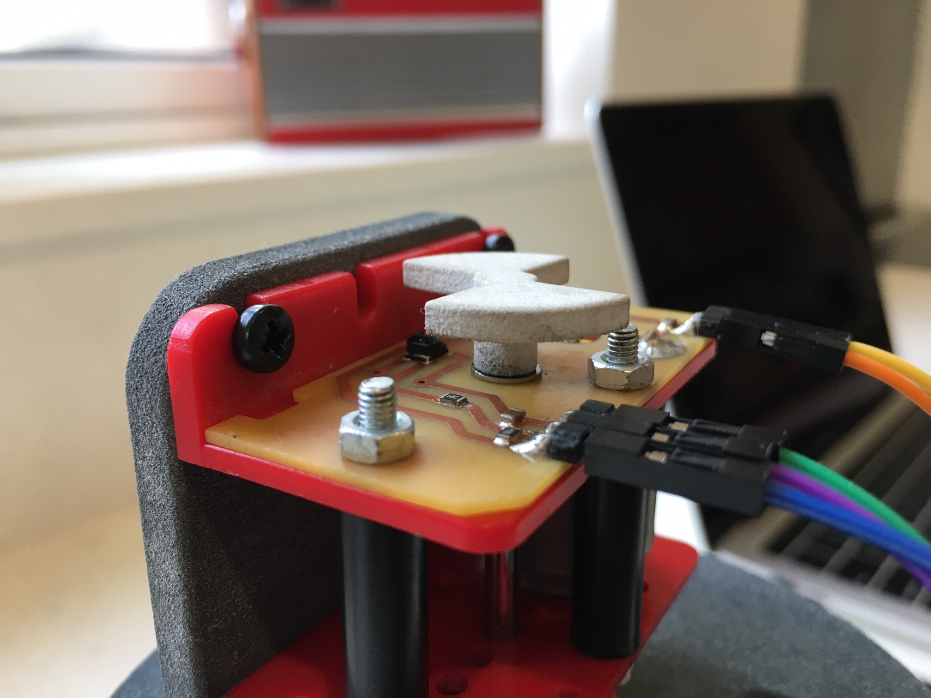

Bioreactor Challenge Motor Speed Controller

Slide 2
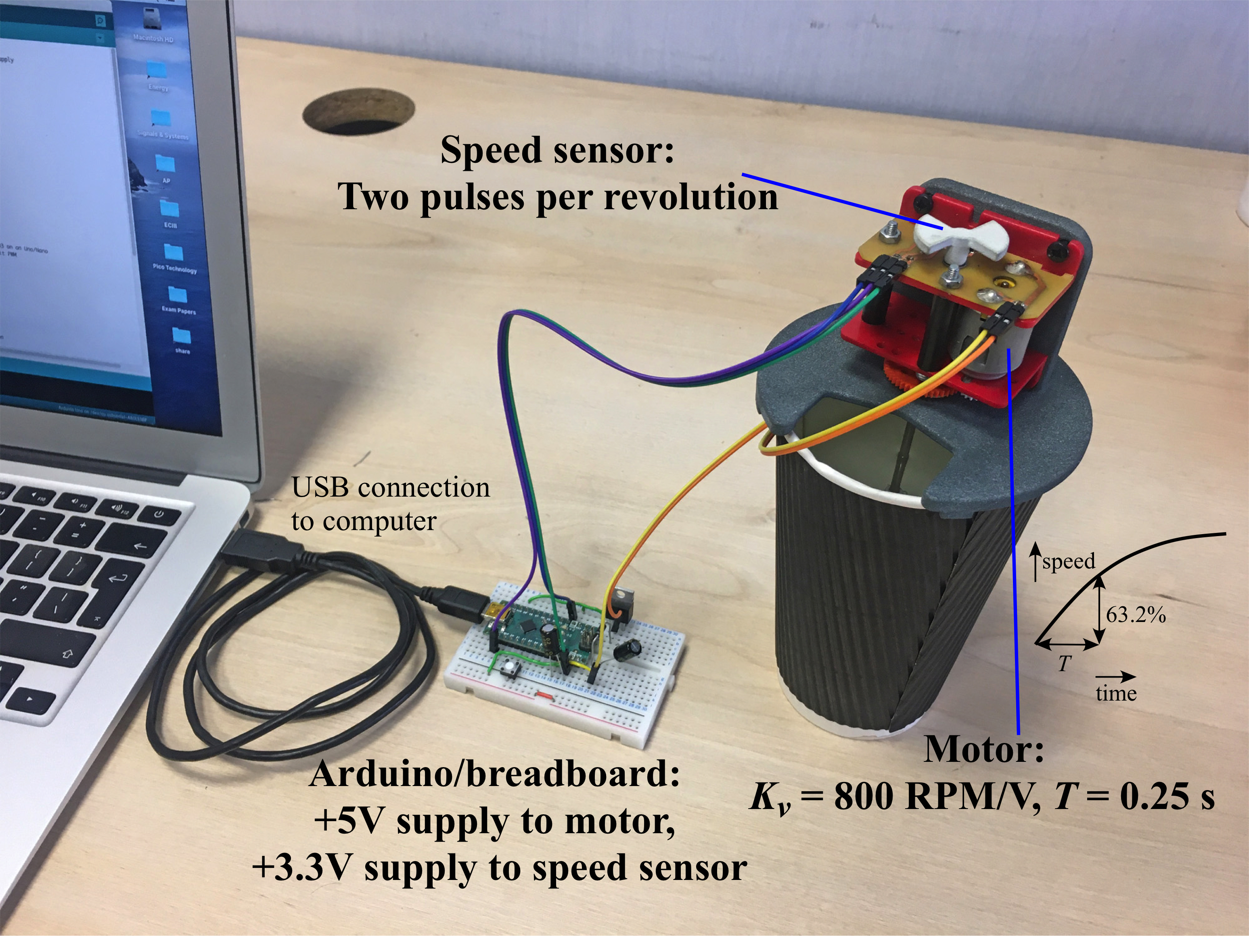
Bioreactor Motor Speed Controller
The system

Slide 3
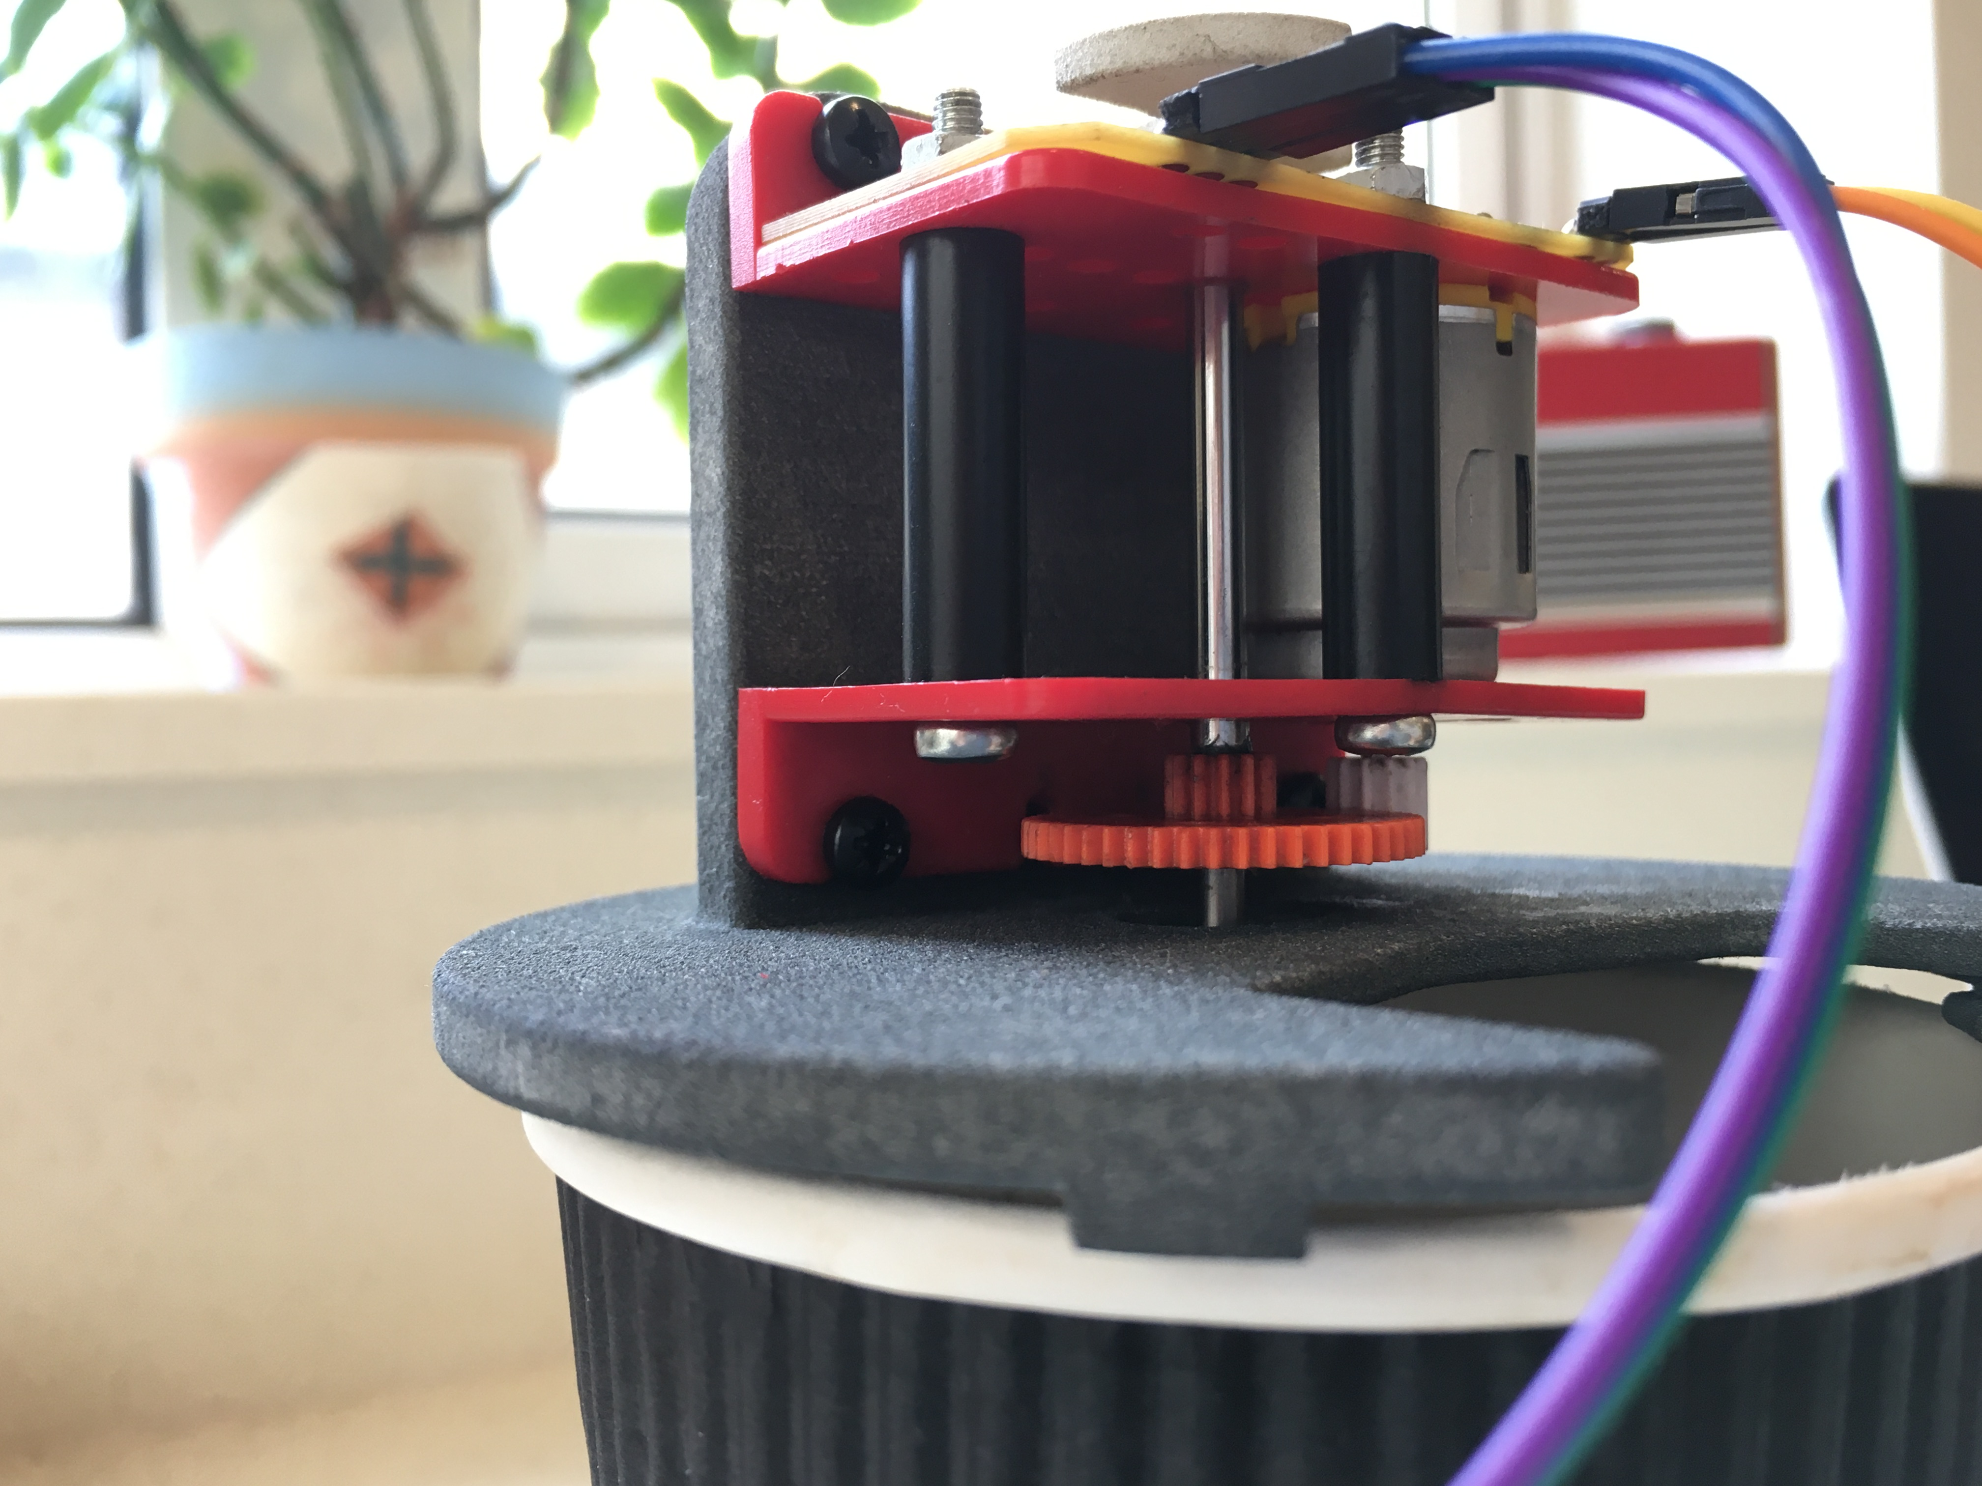
Bioreactor Motor Speed Controller
Motor/gear/paddle/speed sensor assembly
The motor supply is 0-3 V but it should be powered from the Arduino 5 V supply, as this can give a greater current than the 3.3 V supply. An external supply is not necessary.
Make sure your code does not allow the motor voltage to rise above 3 V or the motor may be damaged.
The optical speed sensor produces two pulses per revolution and must be powered from a 3 V or 3.3 V supply. The Arduino 3.3 V supply is ideal.

Slide 4
Bioreactor Motor Speed Controller
PI motor speed controller
The aim is to control the motor speed over the range 500-1500 RPM.
A PI (proportional-integral) controller is a good choice for this system as it adjusts the motor speed to the required value with zero error.
It is easy to implement in a micro-controller, but a few basic considerations are needed to make it work properly.
The basic analysis of a PI controller is beyond the scope of Term 1, but the main results are given here.
The PI controller comprises:
a proportional element of value K_{p} (Volts per RPM) and
an integral element of value K_{I} (Volts per Second per RPM).
The controller conditions the error between the desired motor speed and the measured motor speed to provide a motor voltage that adjusts in order to regulate motor speed to the desired value.

Slide 5
Bioreactor Motor Speed Controller
The values of the two PI controller parameters depend on the motor characteristics: the motor constant, K_{V}, which is the speed in RPM per Volt of supply voltage, and the motor time constant, T, which is the time taken to reach 63.2 % of the settled speed.
The design equations are:
where:
ω_{o} is the response frequency of the motor (rad/s) = 1/T;
ω_{n} is the natural frequency of the control system (in rad/s), the settling time being approximately 2π/ω_{n};
is the damping factor of the control system, a low damping factor causing overshoot and ringing, a high damping factor causing a slow response time.
= 1 and ω_{n} = 0.5ω_{o} to ω_{o} are good design choices.
You now have enough information to design the PI controller!

Slide 6
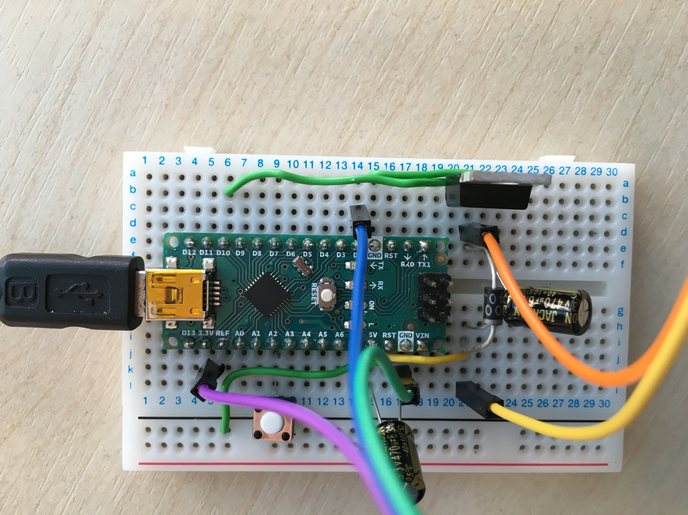
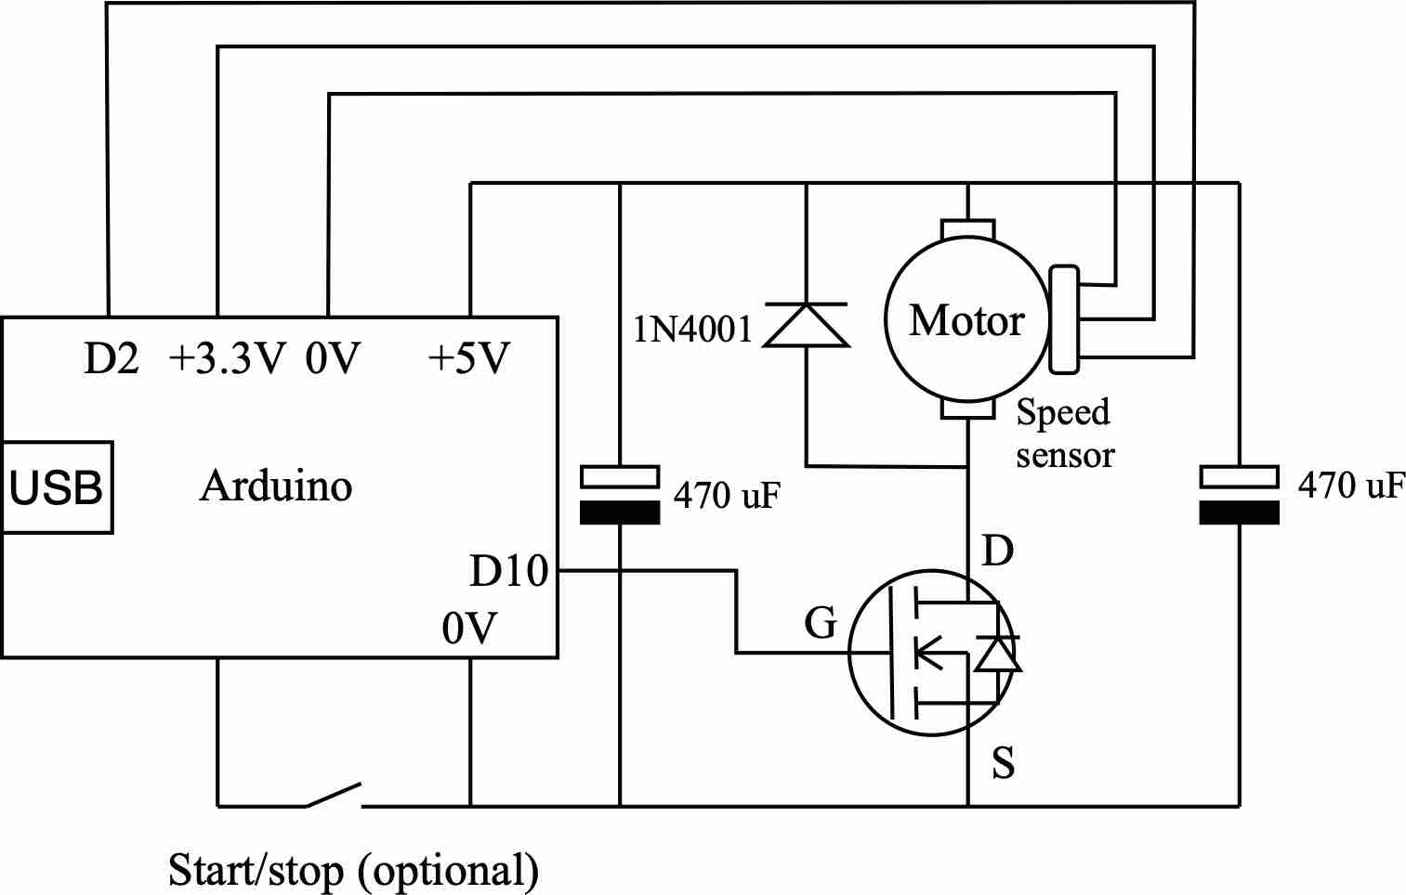
Bioreactor Motor Speed Controller
Circuit design
Note the two 470 μF capacitors across the 5V supply rail (close to the Arduino and motor).
These are crucial to prevent false-triggering of the sensor input from PWM current spikes.
A good MOSFET must be used with a low ‘on’ resistance. Not a weedy bipolar transistor!
The motor must be powered from the 5V supply, the speed sensor from the 3.3V supply.
Only Pins 9 or 10 can be used for 7.8 kHz, 10-bit PWM
Only pins 2 or 3 (the interrupt pins) can be used for the speed sensor signal.

Slide 7
Bioreactor Motor Speed Controller
Code
The Arduino code is in several, distinct, sections, usually in the following order:
Declaration of variables/constants
These can be declared at the top, which is good practice, or within the code. If they are declared at the top then they are global variables, which will work across all parts of the code (body, interrupt routines, etc).
For example:
// Motor (plant) parameters
const float Kv=800; // motor speed constant in RPM per Volt
const float T=0.25;// motor and load time constant (s)
const byte encoderpin=2, motorpin=10;
float setspeed; // Desired (set) motor speed, 500-1500 RPM
There are many other constants/variables to declare and many formats to choose from, such as integer, long integer, float, byte, bool, signed or unsigned.

Slide 8
Bioreactor Motor Speed Controller
Code
2. Setup
This is where I/O pins are assigned, interrupts are attached, serial comms are enabled etc. The code here runs just the once, at the start. For instance:
void setup() {
pinMode(encoderpin, INPUT); // One of the interrupt pins, either D2 or D3 on an Uno/Nano
pinMode(motorpin, OUTPUT); // Use pin 9 or 10, configured for fast 10-bit PWM
pinMode(A2,INPUT_PULLUP);
attachInterrupt(digitalPinToInterrupt(encoderpin), freqcount, RISING);
Serial.begin(9600);
// Pins D9 and D10 - 7.8 kHz 10bit PWM
TCCR1A = 0b00000011; // 10bit
TCCR1B = 0b00000001; // 7.8 kHz
}
As you can see, I/Os need to be defined as inputs or outputs (the default being an input). It is possible to assign input pullup resistors, which can be useful at times.
The standard PWM is 8-bit and slow, but the above sets up a much better PWM.

Slide 9
Bioreactor Motor Speed Controller
Code
3. Loop
This is the main part of the program, which executes over and over again in a loop:
void loop() {
Your code goes here!
}
You will need to think how to make the system work.
There is no one solution, but some are better than others!
Try to make the code efficient (so it executes quickly), elegant, and with carefully thought out features that ensure correct operation under different conditions.
The following gives some basic information that may be useful…

Slide 10
Bioreactor Motor Speed Controller
Code
3. Loop
Measuring and/or regulating the loop time
The loop executes at an undefined speed depending on the code. It may be very fast (< 1 ms say) or much slower. Writing to Serial can be quite slow. For the PI controller, it is important to know and/or control the speed. The following is a neat way of both accurately measuring and regulating the loop speed, to a period of10 ms:
currtime = micros();
deltaT = (currtime-prevtime)*1e-6; // measure deltaT for integration
if (currtime-T1>0) {
prevtime = currtime;
T1=T1+10000; // 10 ms update period (delay)
More code goes here…
}
Should T1, currtime, prevtime, deltaT be integer, long integer, float…?
You must decide.

Slide 11
Bioreactor Motor Speed Controller
Code
3. Loop
Measuring the speed error
You may wish to use a short interrupt routine to measure the frequency of the speed sensor pulses. It is a simple matter to convert frequency to speed in RPM and then to the error between the actual (measured) speed and the required (set) speed. For instance:
measspeed=freq*30; // measured speed in RPM (two counts per revolution)
if (currtime-pulseT>5e5) {measspeed = 0; meanmeasspeed=0;} // Indicate zero measured speed if no pulses detected for 0.5 s
if (measspeed<2000 && measspeed >=0) { // Attempt to mitigate sensor false triggers due to PWM current spikes
error = setspeed-measspeed;
Some extra features are indicated here, which work around some practical issues that may be encountered. This is all part of the fun!

Slide 12
Bioreactor Motor Speed Controller
Code
3. Loop
Implementing PI control
This is a surprisingly simple part of the code. It requires numerical integration of the error, making use of our knowledge of the loop delay, deltaT. And then calculation of the motor voltage based on a component proportional to the error and another component proportional to the integral of the error. For example:
interror = interror+error*deltaT*control; // integral of error, control variable prevents runaway during under/over voltage
Vmotor = round(204*(Kp*error+KI*interror)); // PI controller: scale by 1023 levels/5 V ADC resolution
Note the care here taken with scaling: the PWM function has a range of 0-1023, hence the scale factor. Vmotor here is an integer, hence the conversion from a float, using round, as a precaution – this would probably happen anyway in the compiler.
Why is there a control variable (boolean as it happens)?

Slide 13
Bioreactor Motor Speed Controller
Code
3. Loop
Writing to the motor and serial monitor
Now we just need to write the motor voltage to the motor.
But perhaps it needs a bit of conditioning, to stop it straying beyond 0-3 Volts, say?
control=1;
if (Vmotor<0) {Vmotor=0; interror=interror+1/KI/10000; if (interror<-1/KI) {control=0;}} // underflow prevention
if (Vmotor>600) {Vmotor=600; interror=interror-1/KI/10000; control=0;} // overflow prevention (Vmax = 5*600/1023 = c. 3 V)
analogWrite(motorpin,Vmotor);
Serial.println(measspeed);
As well as restricting the motor voltage to 0-600 (c. 0-3 V), there are other things going on here. One of them it to pause the integration process (so that’s what control does!) If we didn’t do this then if the motor were unable to reach set speed the integrator would continue to integrate for a long time and would struggle to return. There are always surprises, but these have to be spotted and solutions found.

Slide 14
Bioreactor Motor Speed Controller
Code
4. Functions and/or interrupt routines
These can go anywhere, but after the loop is a good place.
Measuring speed sensor indicated frequency
The pulseIn() function is available for this purpose. Some people find this function unreliable, so it may be preferable to use an interrupt routine, such as:
/////////////////////////// Interrupt routine to measure frequency ///////////////////////////
void freqcount() {
pulseT=micros();
freq=1e6/float(pulseT-prevpulseT); // Calculate speed sensor frequency
prevpulseT=pulseT;
}

Slide 15
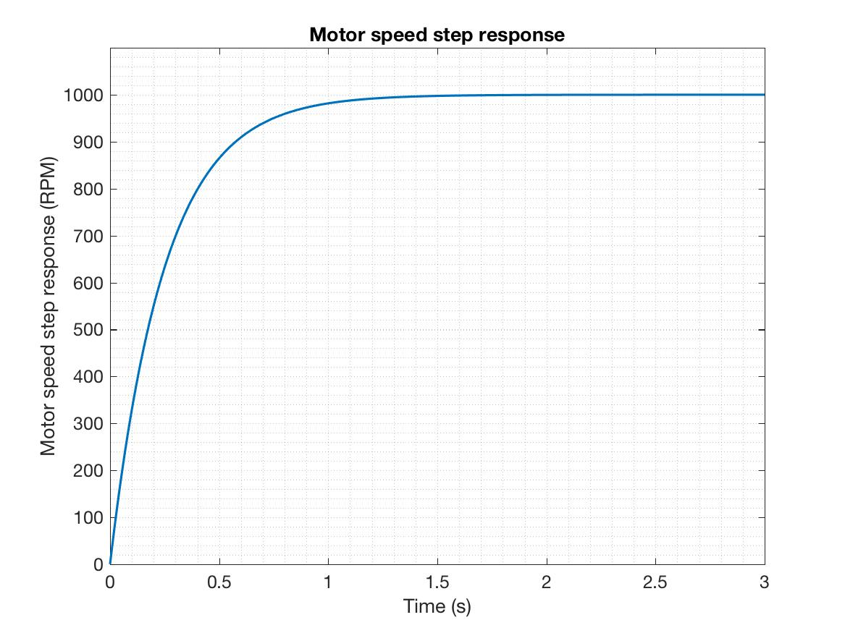
Bioreactor Motor Speed Controller
Recording experimental results
Try using CoolTerm: a freeware terminal emulator that allows data capture to a .txt file for import into Matlab or Excel etc.
This is a great way of recording the response of your system, you can even compare it to theory…
Measured
Modelled
You can use the following Matlab code (or similar) to model the step response, if you are interested. This needs installation of the control systems toolbox.

Slide 16
Bioreactor Motor Speed Controller
Optional Matlab code to model the step response of the system
clear all
close all
% Plant parameters
Kv=800; % motor speed constant (rpm per Volt)
T=0.25; % motor time constant (s)
wo=1/T; % corresponding motor response frequency in rad/s
% desired control parameters
wn=4;
zeta=1;
% required PI controller parameters
Kp=(2*zeta*wn/wo-1)/Kv
KI=wn^2/Kv/wo
% Set speed
nset = 1000;
s=tf('s');
plant=Kv*wo/(s+wo); % Plant transfer function
PID=Kp+KI/s; % PID transfer function
closedloopTF=PID*plant/(1+PID*plant); % Closed-loop transfer function
% Calculate and plot step response
t=0:0.01:3;
[stepresp,t]=step(closedloopTF,t); % Unit-step response
stepresp=nset*stepresp;
figure
plot(t,stepresp,'LineWidth',1.5)
ylim([0 1.1*max(stepresp)])
grid minor
xlabel('Time (s)', 'fontsize', 12)
ylabel('Motor speed step response (RPM)', 'fontsize', 12)
set(gca,'fontsize',12)

